Slide 1
MONEY MATTERS: A PERSONAL FINANCE MANAGEMENT APP

Slide 2
"Money Matters: A Personal Finance Management App" is designed to help individuals take control of their financial lives through an intuitive and user-friendly platform. The app enables users to track their income, expenses, and savings, set and manage budgets, and plan for future financial goals. By providing tools for automatic transaction syncing, bill reminders, debt management, and investment tracking, the app offers a comprehensive approach to personal finance. Through insightful reports and actionable recommendations, it empowers users to make informed decisions, improve financial habits, and work toward achieving their long-term financial objectives. With a focus on security, privacy, and accessibility, "Money Matters" aims to simplify financial management, reduce stress, and enhance users' overall financial well-being. Whether you're a student, professional, or retiree, this app provides the necessary tools to achieve greater financial freedom and stability.

Slide 3
package com.example.expensestrackerimport android.annotation.SuppressLintimport android.content.Contextimport android.content.Intentimport android.os.Bundleimport android.widget.Toastimport androidx.activity.ComponentActivityimport androidx.activity.compose.setContentimport androidx.compose.foundation.layout.*import androidx.compose.material.*import androidx.compose.runtime.*import androidx.compose.ui.Alignmentimport androidx.compose.ui.Modifierimport androidx.compose.ui.graphics.Colorimport androidx.compose.ui.platform.LocalContextimport androidx.compose.ui.text.font.FontWeightimport androidx.compose.ui.text.style.TextAlignimport androidx.compose.ui.unit.dpimport androidx.compose.ui.unit.sp

Slide 4
class AddExpensesActivity : ComponentActivity()
{
private lateinit var itemsDatabaseHelper: ItemsDatabaseHelper private lateinit var expenseDatabaseHelper: ExpenseDatabaseHelper @SuppressLint("UnusedMaterialScaffoldPaddingParameter")
override fun onCreate(savedInstanceState: Bundle?)
{
super.onCreate(savedInstanceState)
itemsDatabaseHelper = ItemsDatabaseHelper(this) expenseDatabaseHelper = ExpenseDatabaseHelper(this)
setContent {
Scaffold(
// in scaffold we are specifying top bar.
bottomBar = {
// inside top bar we are specifying
// background color.
BottomAppBar(backgroundColor = Color(0xFFadbef4),
modifier = Modifier.height(80.dp),
// along with that we are specifying
// title for our top bar.
content = {

Slide 5
Spacer(modifier = Modifier.width(15.dp))
Button(
onClick =
{
startActivity(Intent(applicationContext,AddExpensesActivity::class.java))},
colors = ButtonDefaults.buttonColors(backgroundColor = Color.White),
modifier = Modifier.size(height = 55.dp, width = 110.dp)
)
{
Text(
text = "Add Expenses", color = Color.Black, fontSize = 14.sp, textAlign = TextAlign.Center
)
}
Spacer(modifier = Modifier.width(15.dp))
Button(
onClick = {
startActivity(
Intent(
applicationContext,
SetLimitActivity::class.java
)

Slide 6
},
colors = ButtonDefaults.buttonColors(backgroundColor = Color.White),
modifier = Modifier.size(height = 55.dp, width = 110.dp)
)
{
Text(
text = "Set Limit", color = Color.Black, fontSize = 14.sp,
textAlign = TextAlign.Center
)
}
Spacer(modifier = Modifier.width(15.dp))
Button(
onClick = {
startActivity(
Intent
applicationContext,
ViewRecordsActivity::class.java
)
)
},

Slide 7
colors = ButtonDefaults.buttonColors(backgroundColor = Color.White), modifier = Modifier.size(height = 55.dp, width = 110.dp)
)
{
Text(
text = "View Records", color = Color.Black, fontSize = 14.sp,
textAlign = TextAlign.Center ) }
}
)
}
)
{
AddExpenses(this, itemsDatabaseHelper, expenseDatabaseHelper)
}
}
}}
@SuppressLint("Range")@Composablefun AddExpenses(context: Context, itemsDatabaseHelper: ItemsDatabaseHelper, expenseDatabaseHelper: ExpenseDatabaseHelper)
{
Column(
modifier = Modifier
.padding(top = 100.dp, start = 30.dp)
.fillMaxHeight()
.fillMaxWidth(),
horizontalAlignment = Alignment.Start ) {

Slide 8
val mContext = LocalContext.current
var items by remember { mutableStateOf("") }
var quantity by remember { mutableStateOf("") }
var cost by remember { mutableStateOf("") }
var error by remember { mutableStateOf("") }
Text(text = "Item Name", fontWeight = FontWeight.Bold, fontSize = 20.sp) Spacer(modifier = Modifier.height(10.dp))
TextField(value = items, onValueChange = { items = it },
label = { Text(text = "Item Name") })
Spacer(modifier = Modifier.height(20.dp))
Text(text = "Quantity of item", fontWeight = FontWeight.Bold, fontSize = 20.sp)
Spacer(modifier = Modifier.height(10.dp))
TextField(value = quantity, onValueChange = { quantity = it },
label = { Text(text = "Quantity") })
Spacer(modifier = Modifier.height(20.dp))
Text(text = "Cost of the item", fontWeight = FontWeight.Bold, fontSize = 20.sp)
Spacer(modifier = Modifier.height(10.dp))
TextField(value = cost, onValueChange = { cost = it },
label = { Text(text = "Cost") })
Spacer(modifier = Modifier.height(20.dp))

Slide 9
if (error.isNotEmpty()) {
Text(
text = error,
color = MaterialTheme.colors.error,
modifier = Modifier.padding(vertical = 16.dp)
) }
Button(onClick = {
if (items.isNotEmpty() && quantity.isNotEmpty() && cost.isNotEmpty()) { val items = Items(
id = null,
itemName = items,
quantity = quantity,
cost = cost
)
val limit= expenseDatabaseHelper.getExpenseAmount(1)
val actualvalue = limit?.minus(cost.toInt())
// Toast.makeText(mContext, actualvalue.toString(), Toast.LENGTH_SHORT).show()
val expense = Expense(
id = 1,
amount = actualvalue.toString()
) if (actualvalue != null) { if (actualvalue < 1) { Toast.makeText(mContext, "Limit Over", Toast.LENGTH_SHORT).show() } else { expenseDatabaseHelper.updateExpense(expense) itemsDatabaseHelper.insertItems(items) } } } }) { Text(text = "Submit") } }}

Slide 10
)
if (actualvalue != null) {
if (actualvalue < 1) {
Toast.makeText(mContext, "Limit Over", Toast.LENGTH_SHORT).show()
}
else
{
expenseDatabaseHelper.updateExpense(expense) itemsDatabaseHelper.insertItems(items)
}
}
}
})
{
Text(text = "Submit))

Slide 11
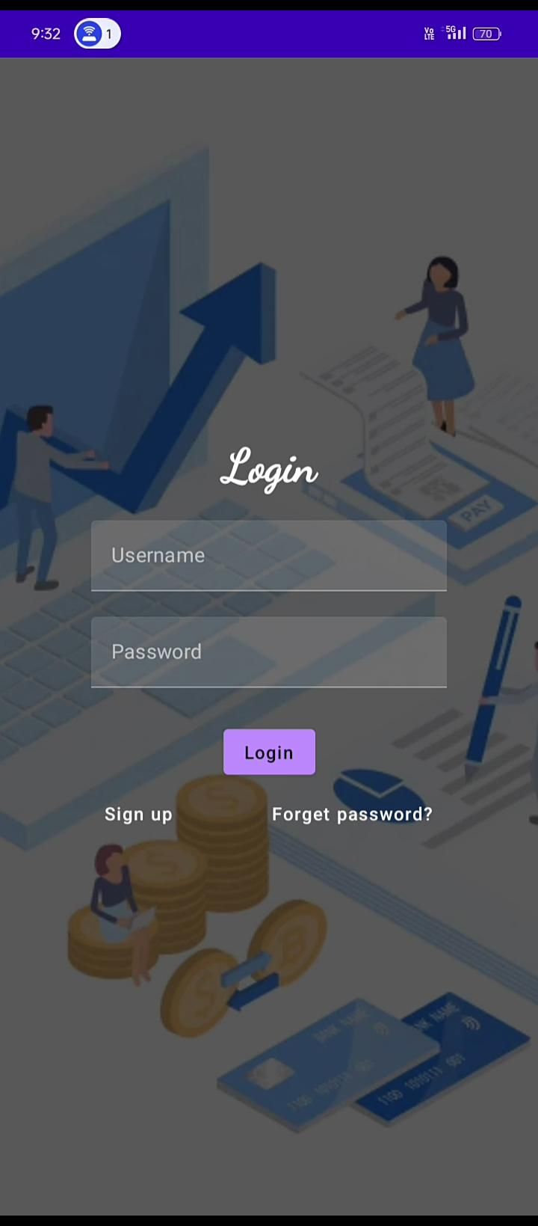
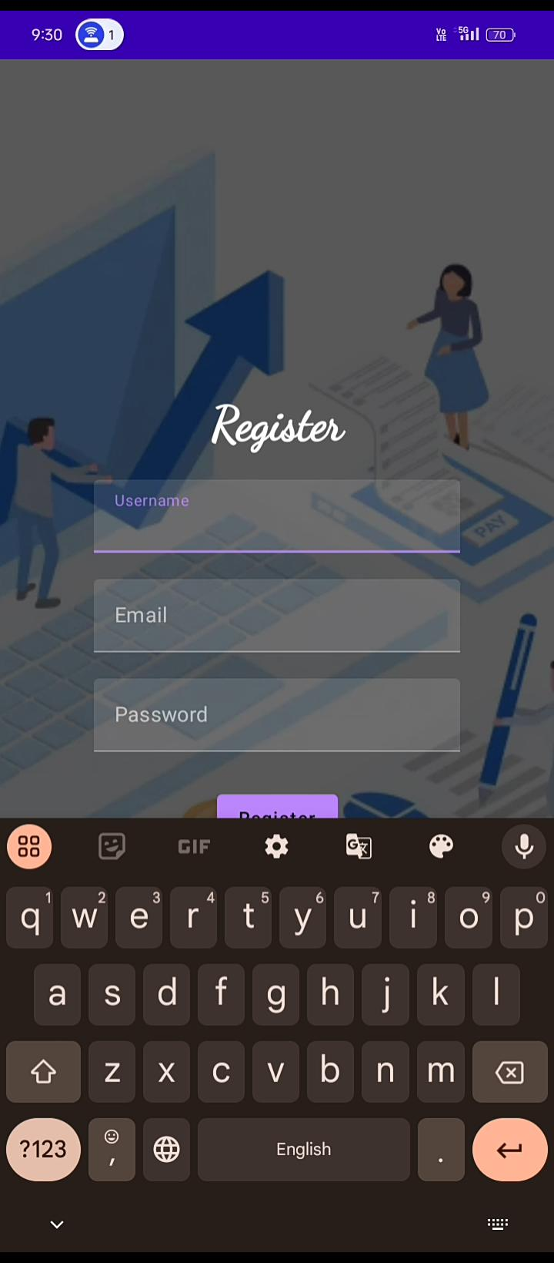
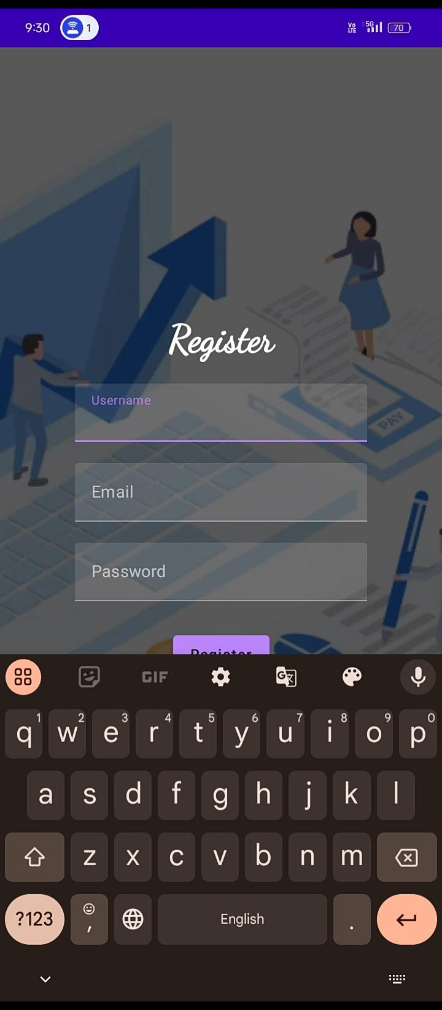

Slide 12
